Slide 1
Machine learning
Regent College London
SWE6204

Slide 2
Machine learning
SWE6204

Slide 3

Machine learning
SUPPORT VECTOR MACHINE
(SVM)

Slide 4
Learning objectives
Understand the concept of SVM
Application of SVM
Advantages and Disadvantages
Keywords: Margins, Hyperplane, SVM and Kernels
Tuning Hyperparameter
C-Reguliarisation Parameter
Gamma-Non linear SVM
Kernel: Linear, Poly and E&F

Slide 5
introduction
SVM was first introduced in the early 1980s by Vladimir Vapnik and Alexey Chervonenkis.
SVMs don't require any pre-processing or normalization of the data set.
The idea is that each observation is a point in space, so there are two different types of points: support vectors and non-support vectors.
The classification boundary line separates these two types of points on either side.
To classify an observation, it is simply determined if it lies closer to one type or another, which can be done by taking its distance from the boundary line for example
Notes:
Pycomates

Slide 6
introduction
Support vector machine is a supervised model.
It looks at data and ..how does predictions work.
Labelled sample data, decision boundary, plotting the new data
predicting the unknown
We are given a set of people with heights and weight.
Lets add new data point and figure out if its a male
We can split two lines, but to predict the gender of a new data point we should split the data in the best possible way. The line which has the maximum space separates the two classes. That is why this lines , We can also say that the distance between the points and the line should be as far as possible. In technical terms, we can say that the distance between the support vector and the hyperplane should be as far as possible.

Slide 7
introDuction
Where support vectors are the extreme points in the dataset.
Here D+ is the shortest distance to the closest positive point.
And D- is the shortest distance to the closest negative points.
Sum of D+ and D- is called the distance margin.
From the distance margin, we get the optimal hyperplane.
Based on the hyperplane, we can say the new data point belongs to the male gender.
As a scientist , we should also be asking, but what happens if the hyperplane is not optimal. If we select a hyperplane having low margin then there is a high chance of misclassification.
But what if my dataset is not having any classification , then we must move from a 1-D view of the data to a 2-D view of the data. For the transformation, we use a kernel function . This will take the 1-D input and transfer it to a 2-D output. If the dataset is like a mixed circle. Then we can split by a line into two classes. So to do that we need to transform 2-D to a 3-D .

Slide 8
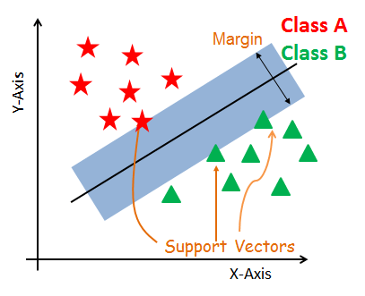
introduction
Support vector machine is mostly considered as a Classification Algorithm but can be used for Regression as well.
SVM constructs a hyperplane in multidimensional space to separate different classes.
SVM generates optimal hyperplane in an iterative manner, which is used to minimize an error.
The core idea of SVM is to find a maximum marginal hyperplane(MMH) that best divides the dataset into classes.
Notes:
https://www.datacamp.com/tutorial/svm-classification-scikit-learn-python

Slide 9
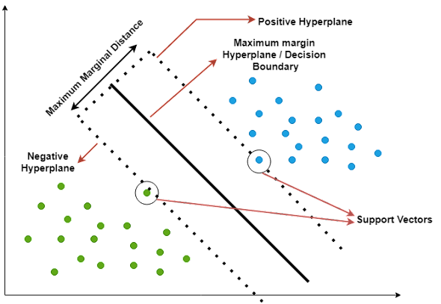
Key terms
Decision Boundary: a line or surface that separates different regions in a data space. Each region is associated with a class label, and the decision boundary is used to predict the class label of new data points.
Decision boundary can be a line or plane that separates the data space into two regions, one associated with the class label +1 and the other with the class label -1.
When the decision boundary is more than 2-dimensional, it is called a hyperplane.
Support Vectors: data points that lie closest to the separating line between the two classes.
Marginal Distance: is the distance between the closest point in the training data set and the decision boundary. Increasing the margin distance can lead to improved generalization performance, ie, better out-of-sample prediction.
Linear Separability: split into two groups using a single line.
Non-linear separability: Non-linear separable data is data that cannot be separated by a linear line.
(Siddarth,2022)
Notes:
Pycomates
(Siddarth,2022)

Slide 10
SVM Working
A hyperplane between the two classes of data, and then finding the best line that separates them. The best line that separates the data is the one that has the most distance from all the data points in one class and the least distance from all the data points in the other class.
To find this line:
SVM uses a technique called “linear regression”. Linear regression finds the best line that fits a set of data points.
to find the line that has the smallest “error”. Error is just a fancy word for the distance between a data point and the line.
SVM uses a technique called “support vectors”: Support vectors are data points that lie on the hyperplane. They are the most important data points because they help to define the hyperplane that can separate the data points.
The decision boundary or decision hyperplane including all the support vectors is the one that maximizes the margin between the two classes.
Notes:
pycomates

Slide 11
SVM Working cont..
Aim of SVM is to increase the marginal distance(as shown in the graph) as much as possible so as to reduce the generalization error.
Increasing the marginal distance will improve the performance of the model on unseen data.
So here what happens is that when the margin distance increases the possibility of predicting the wrong class will decrease since the decision boundary is now far from the points of the two separate classes.
So when considering a new data point, if it lies near to negative hyperplane(shown on the graph) it is more likely to belong to the negative class and if it lies near the positive hyperplane it is more likely to belong to the positive class.
When training the SVM model, we first need to find the support vectors.
Then we need to find the line that maximizes the margin between the two classes.
This line is the decision boundary.
Once we have the decision boundary, we can use it to predict the class of new data points.
Notes:
pycomates

Slide 12
Advantages and disadvantages
SVM Classifiers offer good accuracy
Perform faster prediction compared to Naïve Bayes algorithm.
Uses less memory because they use a subset of training points in the decision phase.
SVM works well with a clear margin of separation and with high dimensional space.
Not suitable for large datasets because of its high training time and it also takes more time in training compared to Naïve Bayes.
It works poorly with overlapping classes
.Sensitive to the type of kernel used.
Notes:
https://www.datacamp.com/tutorial/svm-classification-scikit-learn-python

Slide 13
Tuning hyperparameters
Kernel:
Regularization
Gamma
Kernel: To transform the dataset into the required form
Functions: Linear, Polynomial and RBF- Radial basis function

Slide 14
Tuning hyperparameters
Kernel:
Regularization
Gamma
Regularization: To maintain regularization, C is the penalty parameter.
C represents mis-classification or error term
A small value of C creates Small-margin hyperplane
Larger value of C creates a larger-margin hyperplane

Slide 15
Tuning hyperparameters
Kernel:
Regularization
Gamma
Gamma: Small value loosely fit the training set
Large value exactly fit the training set resulting in overfitting
Low value of Gamma consider nearby points for separation of the line.
High value of Gamma considers all data points for separation of the line.

Slide 16
parameters
C is typically used as a regularization parameter to control overfitting, allowing the algorithm to make more accurate predictions on new data points. The strength of the regularization is inversely proportional to C. C represents the penalty parameter for misclassifying data points.
Simply speaking, C controls the trade-off between maximizing the margin and minimizing training error. If C is set too low, the model will fail to accurately classify data points due to underfitting and can produce inaccurate results. A smaller value of C will result in a larger margin, but may lead to more misclassifications. If C is set too high, then the model will have difficulty correctly separating data points due to overfitting and can show poor accuracy scores. A larger value of C will result in a smaller margin, but may lead to better classification accuracy.
The choice of C depends on the problem at hand and the characteristics of the dataset. In general, a smaller value of C is preferred when the dataset is noisy, or when the goal is to have a more generalizable model that can perform well on new, unseen data. A larger value of C is preferred when the dataset is clean and the goal is to maximize classification accuracy on the training data.
As a general guideline, it’s a good idea to start with a smaller value of C and gradually increase it until the desired level of classification accuracy is achieved. However, it’s important to keep in mind that a larger value of C may lead to overfitting, which means that the model performs well on the training data but poorly on new, unseen data. Therefore, it’s important to strike a balance between maximizing the margin and minimizing the classification error, and choose an appropriate value of C based on the specific problem and dataset.

Slide 17
parameters
When training a support vector machine (SVM) model using Sklearn SVC algorithm, the gamma hyperparameter can take on two special values: ‘scale’, ‘auto’ or ‘float’. When gamma is set to ‘scale’, it means that the value of gamma is calculated as 1 / (number of features * variance in data). This ensures that all features are given equal importance in the model and produces consistent results no matter how many features are used.
SVM kernel is a mathematical function that is used to map the data points from one space into another, usually higher dimensional space. When training a support vector machine (SVM) model using Sklearn SVC algorithm, the kernel hyperparameter can take on several values: ‘linear’, ‘poly’, ‘rbf’ and ‘sigmoid’.
  When kernel is set to ‘linear’, it means that the model will use a linear boundary for classification and regression. This is the simplest type of SVM and works best when data are linearly separable.
  When kernel is set to ‘poly’, it means that the model will use polynomial functions of degree higher than 1 for classification. This type of SVM is more suitable for complex non-linear datasets.
  When kernel is set to ‘rbf’, it means that the model will use radial basis funcitons for classification or regression. RBF kernels are capable of dealing with complex multi-class datasets and have good generalization performance with noisy data points.

Slide 18
Application of svm
Sentiment analysis: A support vector machine can be used to classify the sentiment of a text as positive, negative, or neutral.
Spam detection: Can be used to classify emails as spam or not spam.
Image recognition: Can be used to identify objects in images.
Fraud detection: Can be used to identify fraudulent activity.
Stock prediction: Can be used to predict future stock prices.
Weather prediction: Can be used to predict future weather patterns.
Disease diagnosis: Can be used to diagnose diseases like cancer.
Notes:
https://www.pycodemates.com/2022/07/support-vector-machines-detailed-overview.html

Slide 19
Overview: svm
Works well for classifying higher-dimensional data (lots of features)
Finds higher-dimensional support vectors across which to divide the data (mathematically, these support vectors define hyperplanes. Needless to say I’m not going to get into the mathematical details!)
Uses something called the kernel trick to represent data in higher- dimensional spaces to find hyperplanes that might not be apparent in lower dimensions

Slide 20
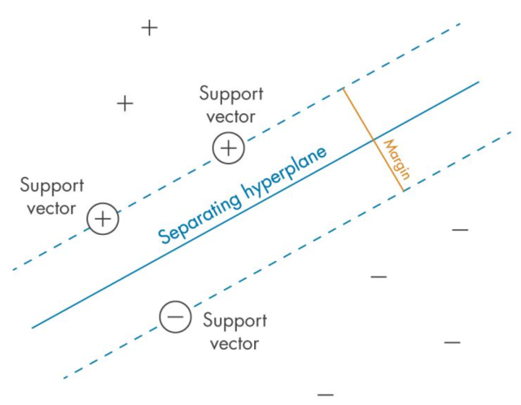
SVM
Support Vector Machines (SVMs) are a powerful and versatile machine learning algorithm that has gained widespread popularity among data scientists in recent years.
SVMs are widely used for classification, regression, and outlier detection (one-class SVM), and have proven to be highly effective in solving complex problems in various fields, including computer vision (image classification, object detection, etc.), natural language processing (sentiment analysis, text classification, etc.), and bioinformatics (gene expression analysis, protein classification, disease diagnosis, etc.).
At times, SVM for classification is termed as support vector classification (SVC) and SVM for regression is termed as support vector regression (SVR).

Slide 21
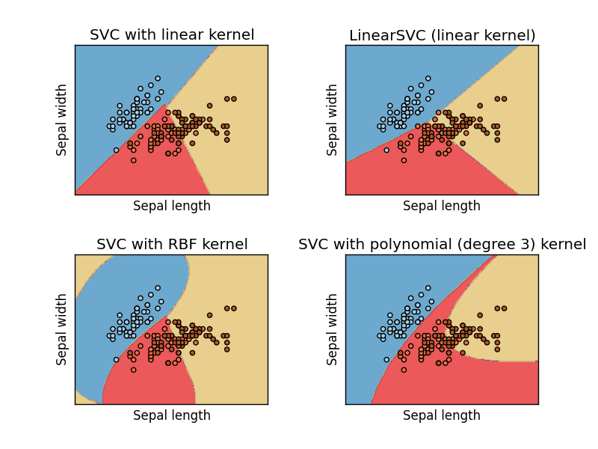
Support vector classification (SVC)
In practice you’ll use something called SVC to classify data using SVM.
You can use different “kernels” with SVC. Some will work better than others for a given data set.

Slide 22
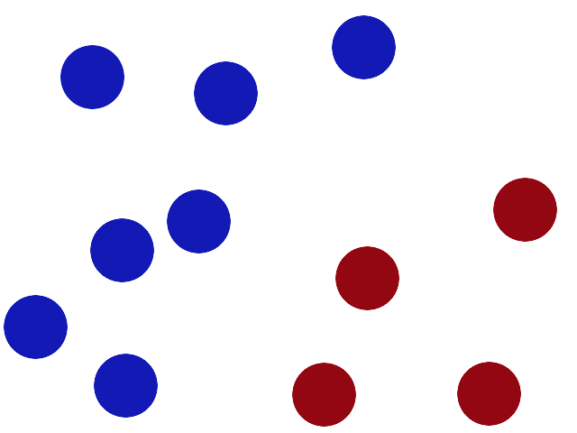
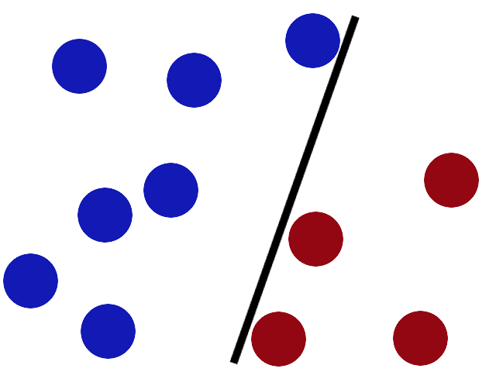
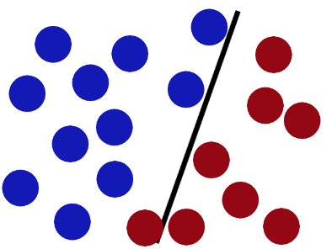
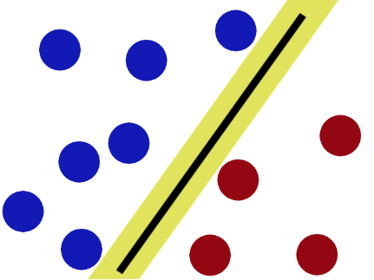
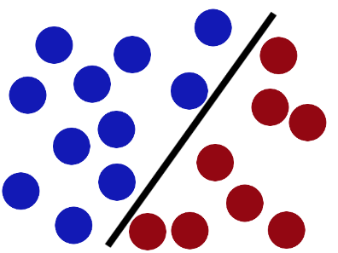
How svm works
Support vector machines (SVM); this classifier works well in complicated feature domains, albeit requiring clear separation between classes.
SVMs don't work well with noisy data
http://i.imgur.com/zDBbD.png
http://i.imgur.com/aLZlG.png
SVMs try to put the stick in the best possible place by having as big a gap on either side of the stick as possible.
http://i.imgur.com/kxWgh.png
http://i.imgur.com/BWYYZ.png
http://i.imgur.com/ePy4V.png
Notes:
JEREMY JORDAN

Slide 23
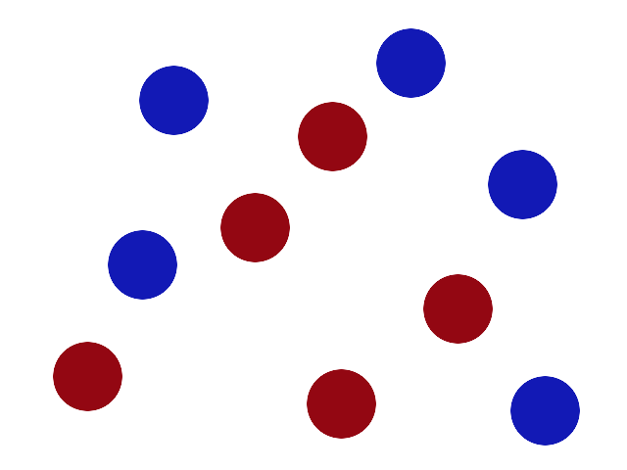
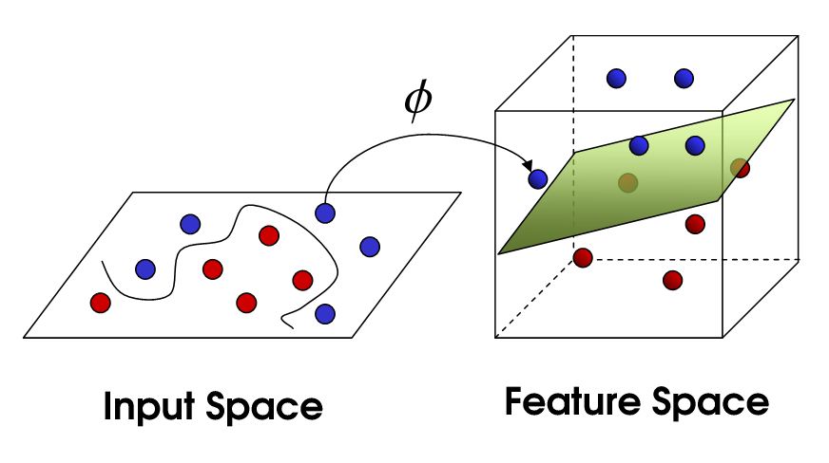
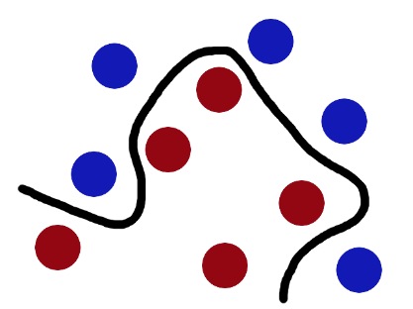
Another challenge
Non-linear SVM:
http://i.imgur.com/WuxyO.png
Balls data, the stick is a classifier, the biggest gap trick is called optimization, flipping the table is called kernelling and the piece of paper a hyperplane.
http://i.imgur.com/gWdPX.png

Slide 24
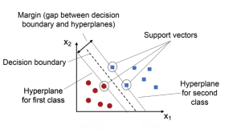
Visual view
Kumar.A. 2023.Support Vector Machine (SVM) Python Example.https://vitalflux.com/classification-model-svm-classifier-python-example/
Kumar.A. 2023
Notes:
The main idea behind SVM classifier is to find a hyperplane that maximally separates the data points of different classes. In other words, we are looking for the largest margin between the data points belonging to two classes. The hyperplane is selected such that it maximizes the distance between the hyperplane and the closest data points from each class, which are called support vectors. These points have a direct impact on the position and orientation of the hyperplane. The rationale behind having decision boundaries with large margins is that they tend to have a lower generalization error, whereas models with small margins are more prone to overfitting. Hence, SVM classifier is also termed as maximum margin classifier, meaning that it finds the line or hyperplane that has the largest distance to the nearest training data points (support vectors) of any class. The following picture represents the same.

Slide 25
example
Given labeled training data (for supervised learning), the SVM classification algorithm outputs an optimal hyperplane which categorizes new data examples into different classes.
This hyperplane is then used to make predictions on new data points. Let’s take an example to understand Support Vector Machine concepts in a better manner. Say you have been asked to predict whether a customer will churn or not and you have all their past transaction records as well as demographic information.
After exploring the data, you’ve found that there’s not much difference between the average transaction amount of customers who churned and those who didn’t. You also found that most of the customers who churned live relatively far from the city center.
Based on these findings, you decided to use Support Vector Machine classification algorithm to build your prediction model. Model trained using SVM classification algorithm will be able to classify the customers as high risk (churned) or otherwise.
There are some key concepts that are important to understand when working with SVMs. First, the data points that are closest to the hyperplane are called support vectors. Second, when the data is not linearly separable, SVMs use a technique called kernel trick, which maps the original features into a higher-dimensional feature space where the data is linearly separable.
In this new feature space, we can draw a hyperplane that separates the two classes. three hyperparameters that results in different SVM models (hypothesis): C, gamma and kernel function.

Slide 26
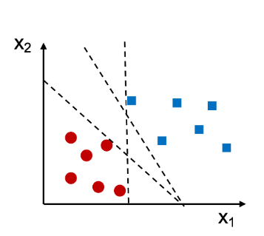
example
As an example, let’s say we have a dataset with two features (x1 and x2) and two classes (0 and 1). We can visualize this data by plotting it in a two-dimensional space, with each point colored according to its class label. Look at the diagram below.
In the above case, we can see that there are different straight lines that can perfectly separate the two classes.
However, we can still find a decision boundary that does a pretty good job.
This boundary is generated by Support Vector Machine algorithm. Using SVM algorithm, as mentioned above, training the model represents finding the hyperplane (dashed line in the picture below) which separates the data belonging to two different classes by maximum or largest margin. And, the points closest to this hyperplane are called support vectors.

Slide 27

visual
The blue square points represent one class and the red dots represent another class. The black line is the decision boundary learned by an SVM.
As you can see, the SVM has placed the boundary in such a way as to maximize the margin between the two classes. Here is a visual representation of how SVM classification works.
The most important hyperparameters are the kernel function and the regularization parameters such as C and gamma.
The kernel function determines how data points are transformed into higher dimensional space
Regularization parameter controls the trade-off between model complexity and overfitting.

Slide 28
example
from sklearn.svm import SVC
from sklearn.metrics import accuracy_score
# Input the kernel from the user
kernels = ['linear', 'rbf', 'poly']
for kernel in kernels:
model = SVC(kernel=kernel)
model.fit(X_train, y_train)
pred = model.predict(X_test)
print("Accuracy using {}:".format(kernel), accuracy_score(pred, y_test))
Notes:
https://www.pycodemates.com/2022/10/classification-of-iris-dataset-using-SVM-in-python.html

Slide 29
Some important hyperparameters that should be considered before training the model:
C: The regularization parameter has a float value and is 1.0 by default. Must be strictly positive.
kernel: Specifies the kernel type used in the algorithm. ‘linear,’ ‘poly,’ ‘rbf.’
degree: An optional integer value to specify the degree of polynomial kernel function which is ignored by all other kernels
gamma: Kernel coefficient for ‘rbf’,’poly’
Notes:
https://www.shiksha.com/online-courses/articles/support-vector-machines-python-code/
svc_diag=SVC(C=10,kernel='rbf',gamma=2)
svc_diag.fit(X_train,y_train)
svc_diag = SVC(C=10,kernel='linear’)

Slide 30
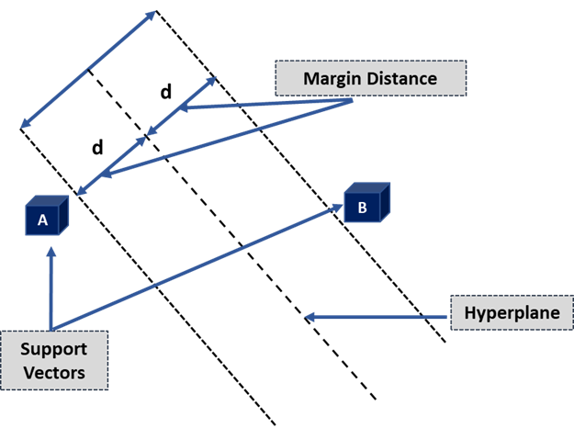
Key terminologies of SVM
1. Hyperplane: or decision boundaries or decision planes: boundaries that aid in the classification of data points.
A hyperplane is a two-dimensional plane when a dataset comprises three features.
2. Support Vectors:
Support vectors are the data points closest to the hyperplane and affect its position.
These vectors are called support vectors because they alter hyperplane location, hence the Support Vector Machine Algorithm.
3. Margin:
The distance between the hyperplane and the support vectors is the margin.
The wider the margin, the more accurate the results are. There are two types of margins in SVM algorithms: hard and soft.
SVM can select two parallel lines that maximize the marginal distance when the training dataset is linearly separable; this is known as a hard margin.
The SVM admits some margin violations when the training dataset is not linearly separable. A soft margin permits some data points to remain on the wrong side of the hyperplane or between the margin and the hyperplane while maintaining accuracy.ypes of SVM
Notes:
https://www.shiksha.com/online-courses/articles/support-vector-machines-python-code/
1. Hyperplane:
Hyperplanes, also known as decision boundaries or decision planes, are the boundaries that aid in the classification of data points. The side of the hyperplane where a new data point lands can be divided into multiple groups. The hyperplane’s dimension is determined by the number of features assigned to a dataset. The hyperplane can be a simple line if the dataset only has two features. A hyperplane is a two-dimensional plane when a dataset comprises three features.
2. Support Vectors:
Support vectors are the data points closest to the hyperplane and affect its position. These vectors are called support vectors because they alter hyperplane location, hence the Support Vector Machine Algorithm.
3. Margin:
The distance between the hyperplane and the support vectors is the margin. The hyperplane that optimizes the margin is always chosen using SVM. The wider the margin, the more accurate the results are. There are two types of margins in SVM algorithms: hard and soft.
SVM can select two parallel lines that maximize the marginal distance when the training dataset is linearly separable; this is known as a hard margin. The SVM admits some margin violations when the training dataset is not linearly separable. A soft margin permits some data points to remain on the wrong side of the hyperplane or between the margin and the hyperplane while maintaining accuracy.

Slide 31
SVM coding video
Watch the video and try to code this in your Python environment
https://www.youtube.com/watch?v=TtKF996oEl8

Slide 32
reference
Siddarth.2022.A Detailed Overview to the Basics of Support Vector Machines in Machine Learning .[Online].Available at: https://www.pycodemates.com/2022/07/support-vector-machines-detailed-overview.html
Kumar.A. 2023.Support Vector Machine (SVM) Python Example.[Online].Available at:https://vitalflux.com/classification-model-svm-classifier-python-example/
Dwarki,V.2022.Support Vector Machines: Python code.[Online].Available at: https://www.shiksha.com/online-courses/articles/support-vector-machines-python-code/
Unfold Data Science.2022.Support vector machine in machine learning | Support vector machine python | SVM parameter tuning.[Online].Available at: https://www.youtube.com/watch?v=VB_OcBYh3bw
Babar,A,Z.2023.How to implement SVM in Python using Scikit-learn.
https://www.educative.io/answers/how-to-implement-svm-in-python-using-scikit-learn
https://www.kaggle.com/code/arshid/support-vector-machine-on-iris-flower-dataset/notebook
SVM 2Dimension-Hyperplane: Visualization | Kaggle

Slide 33
+44 (0)207 016 8000
info@rcl.ac.uk

